Slide 1

Blockchain-enabled Federated Learning For Intrusion Detection in Vehicular Edge Computing
ARSHIYA KHIASUDEEN - 2021115017
SHREE RAIVATH - 2021115103
SHREYA ELIZABETH FRANKLIN - 2021115104
JOBSON CHARLES - 2021115303
GUIDED BY : Dr. M. Vijayalakshmi
DEPT OF IST, CEG CAMPUS

Slide 2
INTRODUCTION
The scale and complexity of modern transportation systems are immense, making them susceptible to numerous security threats.
As Intelligent Transportation Systems (ITSs) become increasingly integrated into our roadways, the potential vulnerabilities within these systems have grown.
ITSs, which include advanced vehicular networks and smart transportation infrastructure, are designed to enhance road safety and efficiency. However, their interconnected nature exposes them to a range of security challenges.
These vulnerabilities can lead to service disruptions, pose significant safety risks to users, and even cause widespread harm. Therefore, it is essential to develop and implement robust security measures that can address these evolving threats and ensure the safe and reliable operation of ITSs.

Slide 3
PROBLEM STATEMENT
Intelligent Transportation Systems (ITS) and vehicular networks face significant security threats, including zero-day attacks, due to insufficient real-time data on emerging threats.
AI-based security solutions have limitations as they require data sharing, which raises privacy concerns when dealing with sensitive information in ITS.
Our project proposes a framework to allow secure, decentralized collaboration between vehicles for intrusion detection, ensuring privacy and system reliability.

Slide 4
OBJECTIVES
PHASE 1:
Secure Intrusion Detection: Develop a blockchain-enabled federated learning system to detect and classify cyberattacks in vehicular edge networks while preserving data privacy.
Enhance Model Accuracy: Utilize ensemble learning methods (XGBoost, LightGBM, and CatBoost) to improve the accuracy and robustness of intrusion detection.
Ensure Data Integrity: Leverage blockchain to securely aggregate model updates, ensuring transparency and protection against malicious tampering.

Slide 5
OBJECTIVES
PHASE 2:
Address Blockchain Vulnerabilities: Implement measures to mitigate blockchain-specific threats like Sybil attacks and unauthorized client participation.
Optimize System Performance: Enhance the system’s efficiency for larger and more dynamic vehicular networks with diverse data sources.
Advanced Aggregation Strategies: Explore improved techniques, such as model pruning and optimized federated averaging, for better global model performance.
Real-Time Adaptation: Integrate real-time network data
to improve the system's responsiveness to emerging threats and evolving attack patterns.

Slide 6
CHALLENGES ADDRESSED
Privacy concerns related to sharing sensitive data for security purposes.
Ensuring trustworthiness and integrity in the decentralized collaborative learning process among edge devices.

Slide 7
SOCIAL IMPACT
Reduces the risk of cyberattacks on transportation systems, enhancing road safety and potentially preventing accidents.
Protects personal data, such as location and driving behavior, ensuring privacy for individuals.
Increases public trust in intelligent transportation systems by improving security and reliability.

Slide 8
LITERATURE SURVEY
TITLE | DETAILS OF PUBLICATION | HIGHLIGHTS | CHALLENGES TO BE ADDRESSED
Blockchain-Enabled Federated Learning for Enhanced Collaborative Intrusion Detection In Vehicular Edge Computing | IEEE TRANSACTIONS ON INTELLIGENT TRANSPORTATION SYSTEMS, VOL. 25, NO. 7, JULY 2024 | Introduces a novel Edge-based Framework that uses Federated Learning (FL) and blockchain to enhance the security and privacy of Intelligent Transportation Systems (ITS) against emerging threats like zero-day attacks. The framework includes a distributed Edge architecture for secure collaboration among nodes and a blockchain-based reputation system to ensure the trustworthiness of the FL process. | Developing AI models that provide clear explanations is crucial to increasing the transparency of the Federated Learning (FL) training process and enabling the identification and prevention of backdoor attacks. Enhancing the scalability of the reputation system presents another significant challenge. Extending our framework to other datasets is necessary to ensure comprehensive testing and validation across diverse scenarios.

Slide 9
TITLE | DETAILS OF PUBLICATION | HIGHLIGHTS | CHALLENGES TO BE ADDRESSED
Federated Intrusion Detection in Blockchain-Based Smart Transportation Systems | IEEE TRANSACTIONS ON INTELLIGENT TRANSPORTATION SYSTEMS, VOL. 23, NO. 3, MARCH 2022 | A Federated Deep Learning-based Intrusion Detection System (FED-IDS) that leverages blockchain technology and Vehicular Edge Computing to enhance the security and privacy of Smart Transportation Systems (STS). The proposed FED-IDS utilizes context-aware Transformer networks to efficiently model and detect cyberattacks in vehicular networks, with decentralized federated training managed by a consortium blockchain. The framework's effectiveness is validated using public datasets. | FED-IDS requires a large amount of labeled vehicular data for training, but labeling is laborious and time-consuming. Future work should focus on leveraging semi-labeled and unlabeled data. The imbalance in training data significantly affects collaborative detection performance. Current blockchain systems face challenges with divergence, limited efficiency, and high computational demands, necessitating new techniques to balance these issues.

Slide 10
TITLE | DETAILS OF PUBLICATION | HIGHLIGHTS | CHALLENGES TO BE ADDRESSED
Blockchain-Enabled Federated Learning With Mechanism Design | IEEE TRANSACTIONS ON INTELLIGENT TRANSPORTATION SYSTEMS VOL. 11,No. 23,DECEMBER 2023 | Integrates blockchain with federated learning for secure, decentralized training. Includes local clients, a central server and smart contracts. Local models are trained on devices and updates are sent via blockchain. Smart contracts automate the aggregation and validation of model updates. Ensures security and privacy Uses algorithms like BRBC for managing node reputation. | Scalability: Handling a large number of clients and transactions. Privacy: Ensuring data privacy and security while aggregating model updates. Latency: delays in model update transactions and communication between clients and the server. Reputation Management: Accurately assessing and managing the trustworthiness of nodes using algorithms like BRBC. Resource Consumption: Balancing the computational and storage demands of blockchain with federated learning requirements.

Slide 11
TITLE | DETAILS OF PUBLICATION | HIGHLIGHTS | CHALLENGES TO BE ADDRESSED
Blockchain-Enabled Federated Learning: A Reference Architecture Design, Implementation, and Verification | IEEE TRANSACTIONS ON INTELLIGENT TRANSPORTATION SYSTEMS Vol. 11,No. 21,DECEMBER 2023 | Architecture: Integrates blockchain with federated learning, featuring local clients, a server, and smart contracts. Implementation: Local models train on devices; updates are securely aggregated on the blockchain. Verification: Ensures privacy and security, manages node reputation with BRBC, and evaluates performance metrics like accuracy and throughput. | Scalability: Efficiently managing large numbers of clients and blockchain transaction. Privacy: Protecting data privacy while aggregating and sharing model updates. Latency: Reducing delays in communication and model update processing. Reputation Management: Accurately assessing and managing node trustworthiness using algorithms like BRBC. Smart Contract Complexity: Developing and managing complex smart contracts reliably.

Slide 12
TITLE | DETAILS OF PUBLICATION | HIGHLIGHTS | CHALLENGES TO BE ADDRESSED
Collaborative Vehicular Edge Computing Networks: Architecture Design and Research Challenges | IEEE TRANSACTIONS ON INTELLIGENT TRANSPORTATION SYSTEMS Vol. 7,No. 05,DECEMBER 2019 | Emerging Applications: AR, autonomous driving, and other applications require heavy computation and storage, challenging traditional vehicular networks. Mobile Edge Computing (MEC): Enhances network capabilities by extending computing and storage resources to the edge. Architecture : Review: Overview of MEC and vehicular networks. Design Principles: Outlines the principles for CVECN. Technical Challenges : Coalition Formation:. Task Offloading. Mobility Management | Formation: Efficiently forming and managing groups of vehicles and edge nodes for effective collaboration. Collaborative Task Offloading: Strategically distributing computational tasks among vehicles and edge nodes to optimize performance. Mobility Management: Handling the dynamic movement of vehicles and its impact on network stability and resource allocation. Data Privacy and Security: Ensuring the confidentiality and integrity of data processed and shared in the network. Latency and Reliability applications. Resource Allocation: Efficiently allocating computing and storage resources

Slide 13
TITLE | DETAILS OF PUBLICATION | HIGHLIGHTS | CHALLENGES TO BE ADDRESSED
CoopEdge+: Enabling Decentralized, Secure and Cooperative Multi-Access Edge Computing Based on Blockchain | IEEE TRANSACTIONS ON INTELLIGENT TRANSPORTATION SYSTEMS Vol. 34,No. 22,DECEMBER 2022 | Decentralization: Blockchain enables edge nodes to cooperate without a central authority, improving scalability and reducing failure points. Security & Trust: Blockchain ensures data integrity and trust through smart contracts and secure interactions between nodes. Cooperation: Nodes share resources (computation, storage) to enhance system efficiency. Challenges Addressed: Solves issues around trust, security, scalability, and resource sharing in MEC. Applications: Suitable for IoT and smart cities where edge computing and decentralized cooperation are critical. | Trust Management: Establishing reliable trust mechanisms among decentralized edge nodes without a central authority. Security: Ensuring secure communication and data sharing between distributed nodes using blockchain technology. Resource Sharing: Efficiently managing and incentivizing cooperative resource (computation, storage) sharing among edge nodes. Scalability: Handling the increasing number of edge devices and data in large-scale, decentralized networks Latency: Minimizing communication delays between edge nodes while maintaining real-time performance.

Slide 14
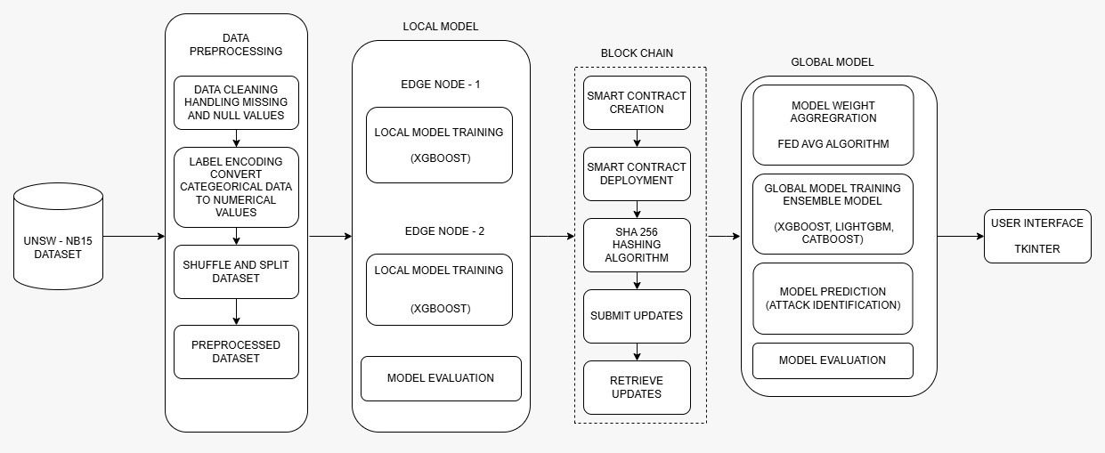
SYSTEM ARCHITECTURE

Slide 15
FUNCTIONALITY OF THE MODULES
Data Preprocessing : Label Encoding, normalization, removal of duplicate data, and the data is split into two and sent to each client.
Local Model Training : Two clients are trained separately using their respective data using an XGBoost classifier.
Blockchain : Smart contract is formulated and deployed. Model updates are stored.
Model Aggregation/Global Model Training : Local model updates are retrieved from blockchain, aggregated and trained in the global server.
User Interface : A user friendly interface is created using Tkinter python library.

Slide 16
MODULE-1
DATA PREPROCESSING :
Label Encoding: Transforms categorical variables into a set of numerical values. Each unique category is assigned an integer value.
Normalization: Scales features to a consistent range, improving model convergence and performance.
Handling NaN values: Replaces NaN values with 0, so that analysis proceeds without any errors and for cleaner data handling.
Data Splitting: Prepares data for federated learning or distributed environments by distributing balanced subsets to different clients.

Slide 17
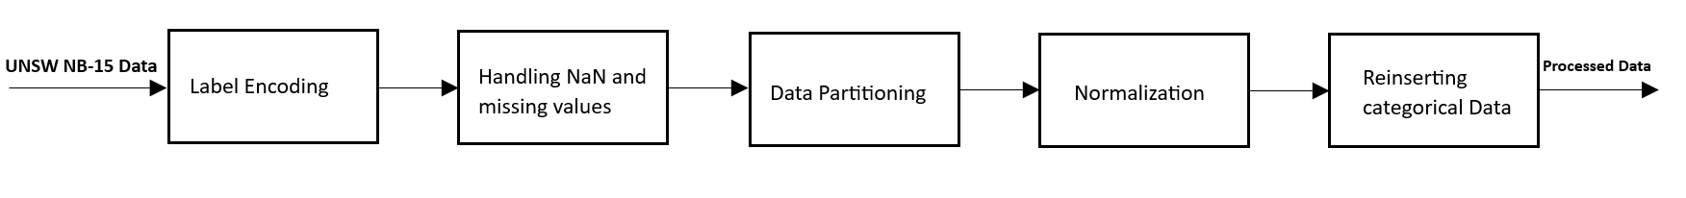
MODULE-1

Slide 18
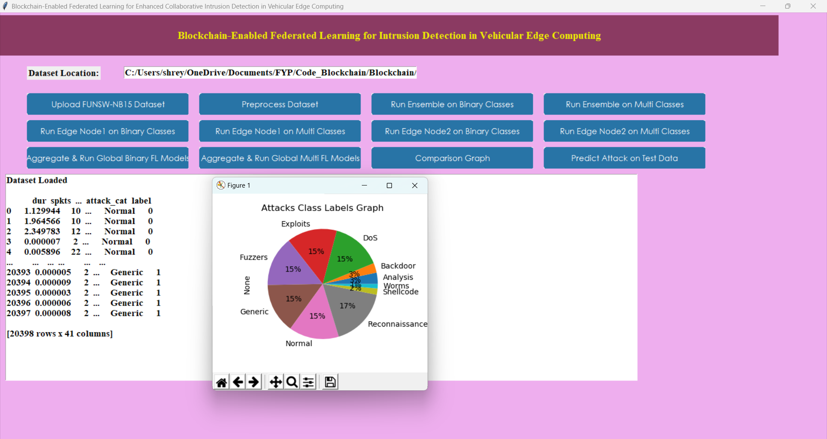
MODULE-1

Slide 19
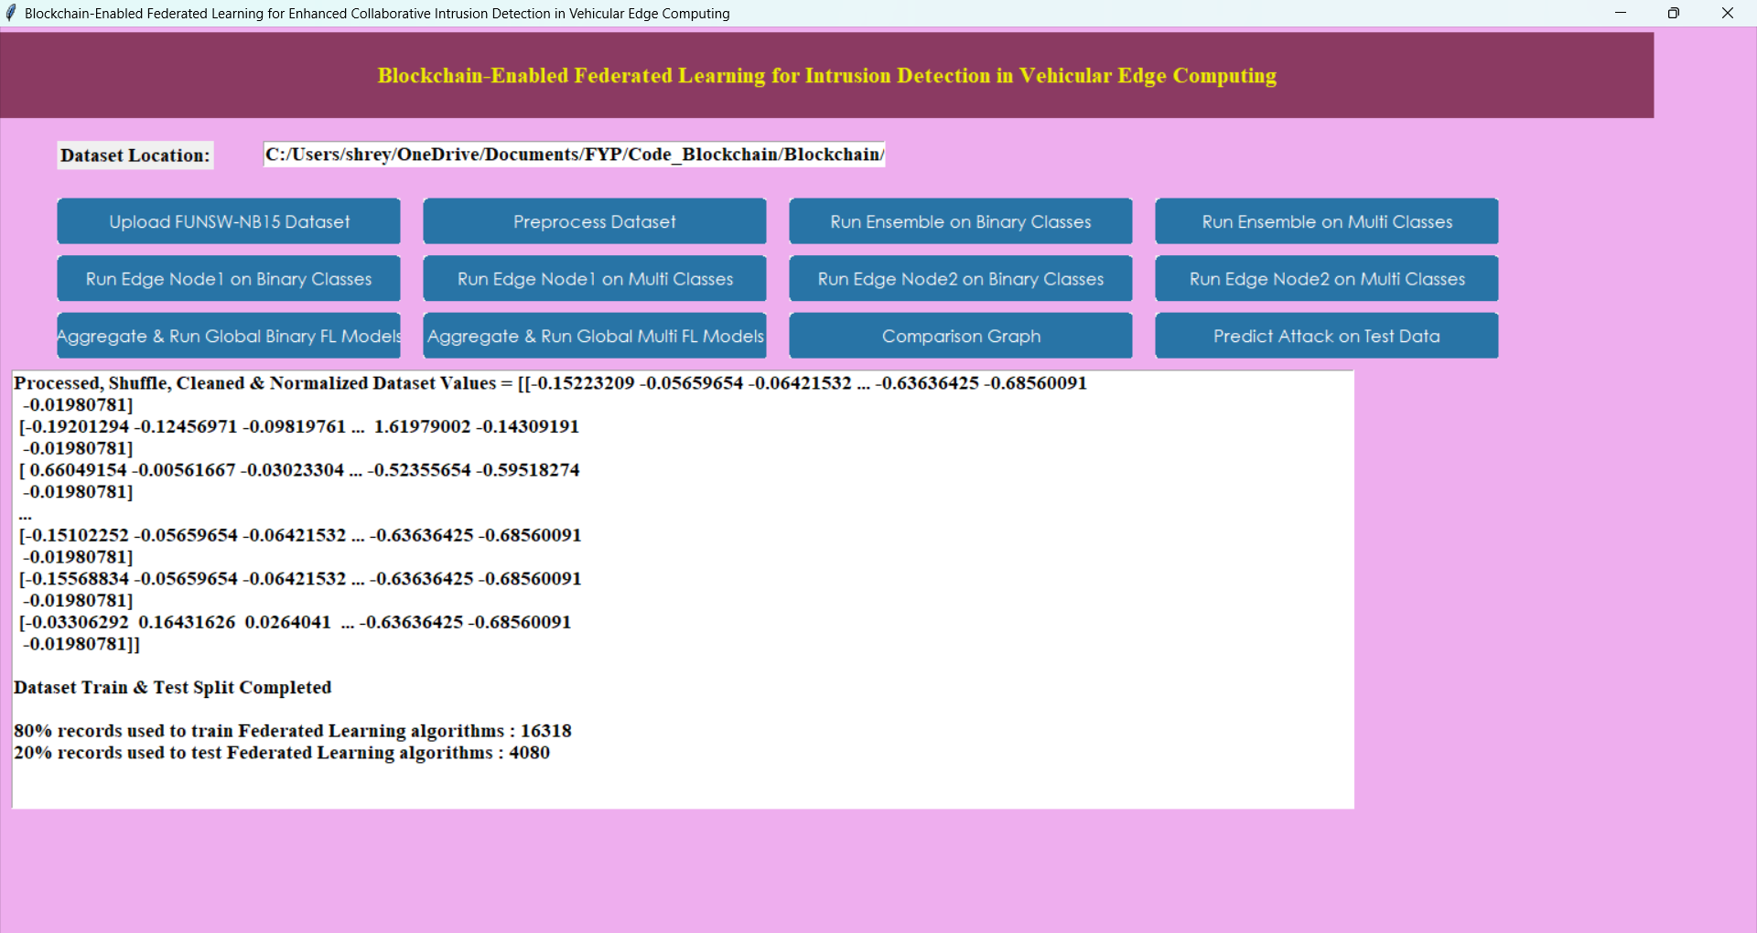
MODULE-1

Slide 20
MODULE-2
Local Model Training:
Two clients (edge node) are independently trained using a XGBoost classification model.
Once the local training is complete, the model updates from each client are generated, reflecting how the model has improved based on their specific data.
These updates are then converted into weights using the stochastic gradient descent (SGD) algorithm, a popular optimization method that adjusts the model's parameters step by step to minimize errors.

Slide 21
Stochastic gradient descent (SGD) algorithm
initialize θ (weights) randomly
choose learning rate η
repeat until convergence:
shuffle the training data
for each training example (x_i, y_i):
1. predict y_hat = f(x_i, θ)
2. compute loss L = L(y_hat, y_i)
3. compute gradient g = ∇_θ L(y_hat, y_i)
4. update θ = θ - η * g

Slide 22
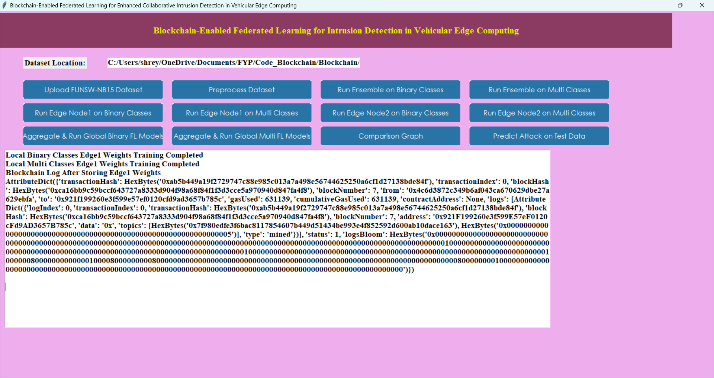
MODULE-2

Slide 23
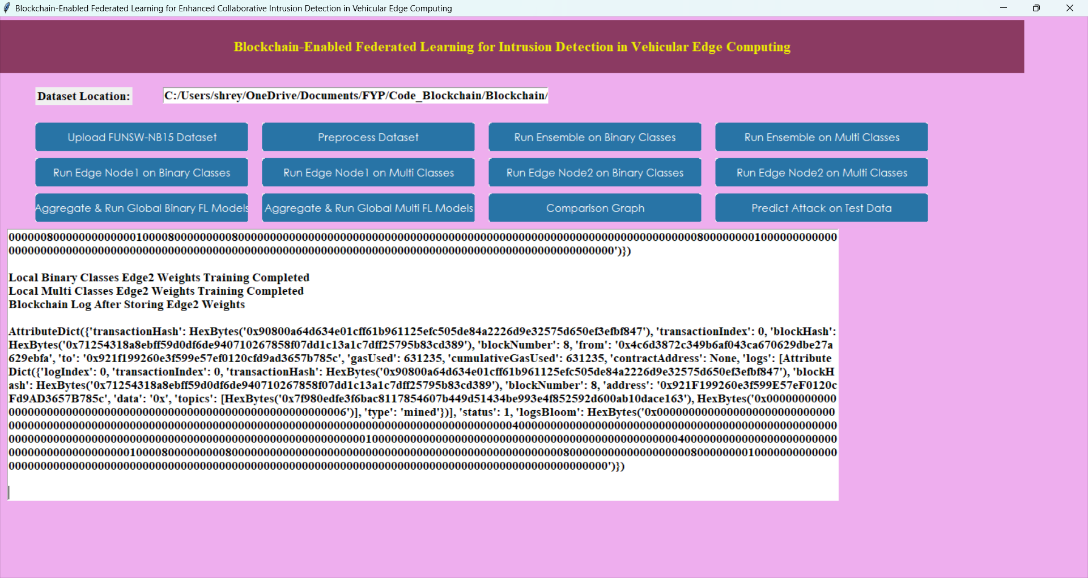
MODULE-2

Slide 24
MODULE-3
Block Chain :
Smart Contracts: Automated, self-executing contracts are drafted to enforce predefined rules and conditions without the need for intermediaries.
Submit Updates: The local Model Updates are hashed using SHA 256 and stored in the blockchain.
Retrieve Updates: The stored updates are retrieved, aggregated and sent to the global model.

Slide 25
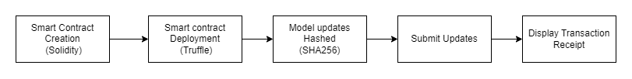
MODULE-3

Slide 26
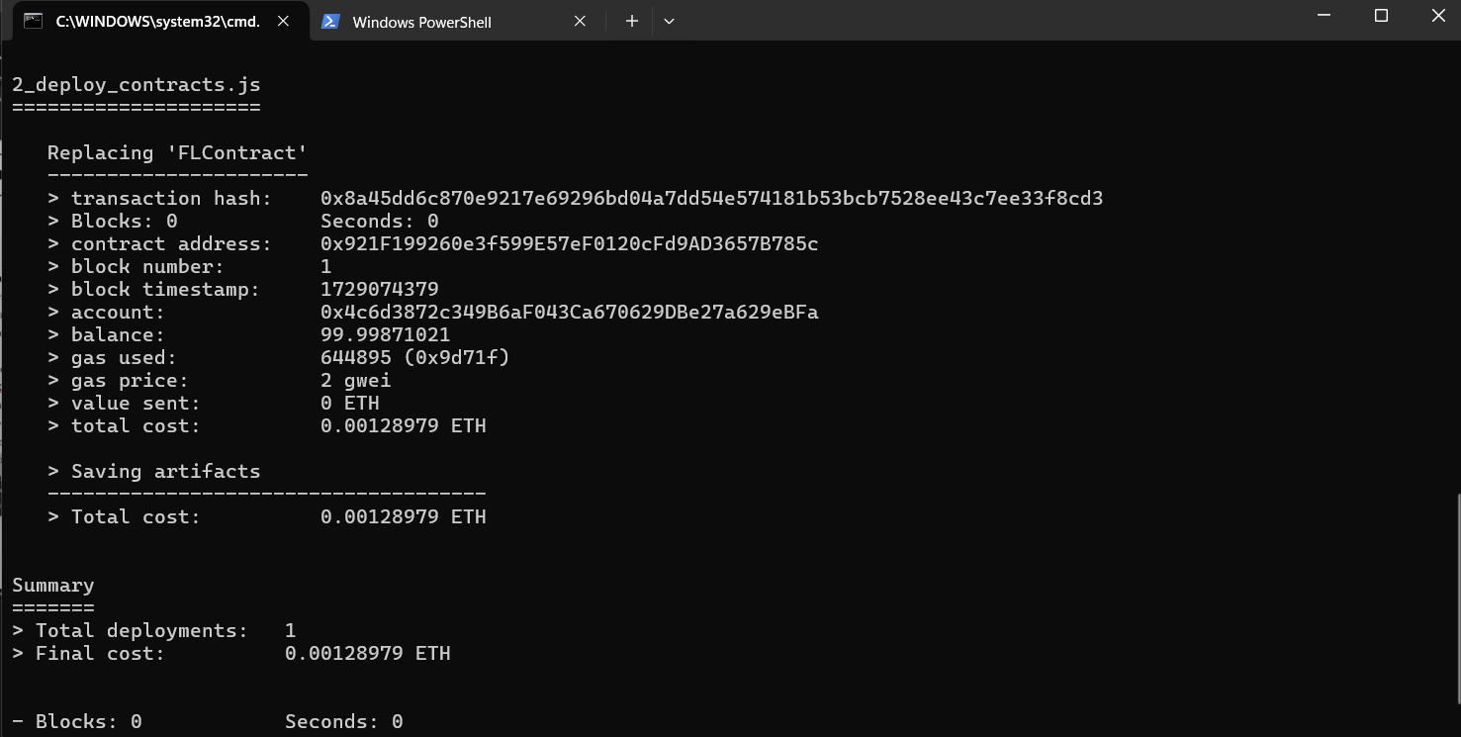
MODULE-3

Slide 27
MODULE-4
Model Aggregation/Global Model Training:
Local Training: Clients train models locally and send updated weights to the server.
FedAvg Aggregation: The server uses the FedAvg algorithm to combine the weights, with more weight given to larger datasets.
Global Model Update: The global model is updated using the aggregated weights.
Model Distribution: The updated global model is sent back to all clients for the next round.
Repeat: This process is repeated over multiple rounds to improve the model continuously.

Slide 28
FedAvg algorithm
initialize global model θ₀
for each round t = 1, 2, ..., T:
Server:
1. choose a random set of clients
2. send the current model to these clients
Each Client:
1. receive the model from the server
2. train the model on their local data
3. send the updated model back to the server
Server:
1. average the models from the clients to create a new global model

Slide 29
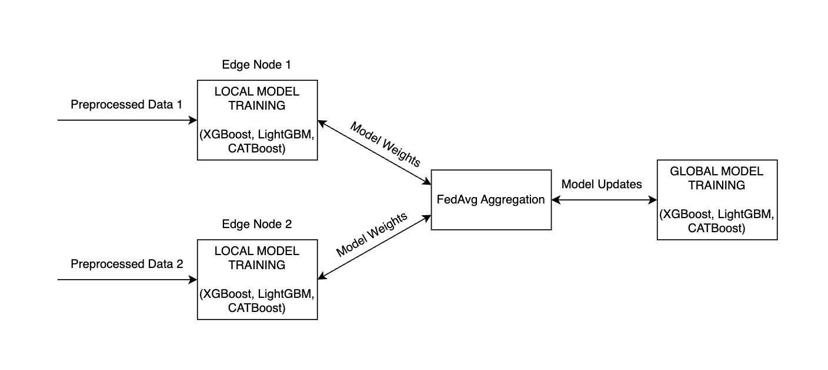
MODULE-4

Slide 30
MODULE-5
User Interface :
Library used : Tkinter
Main Window: The primary container for all other GUI elements.
Widgets: Building blocks like buttons, labels, and text fields.
Layout Managers: Control how widgets are arranged in the main window.
Event Loop: Keeps the application running, waiting for user interactions.

Slide 31
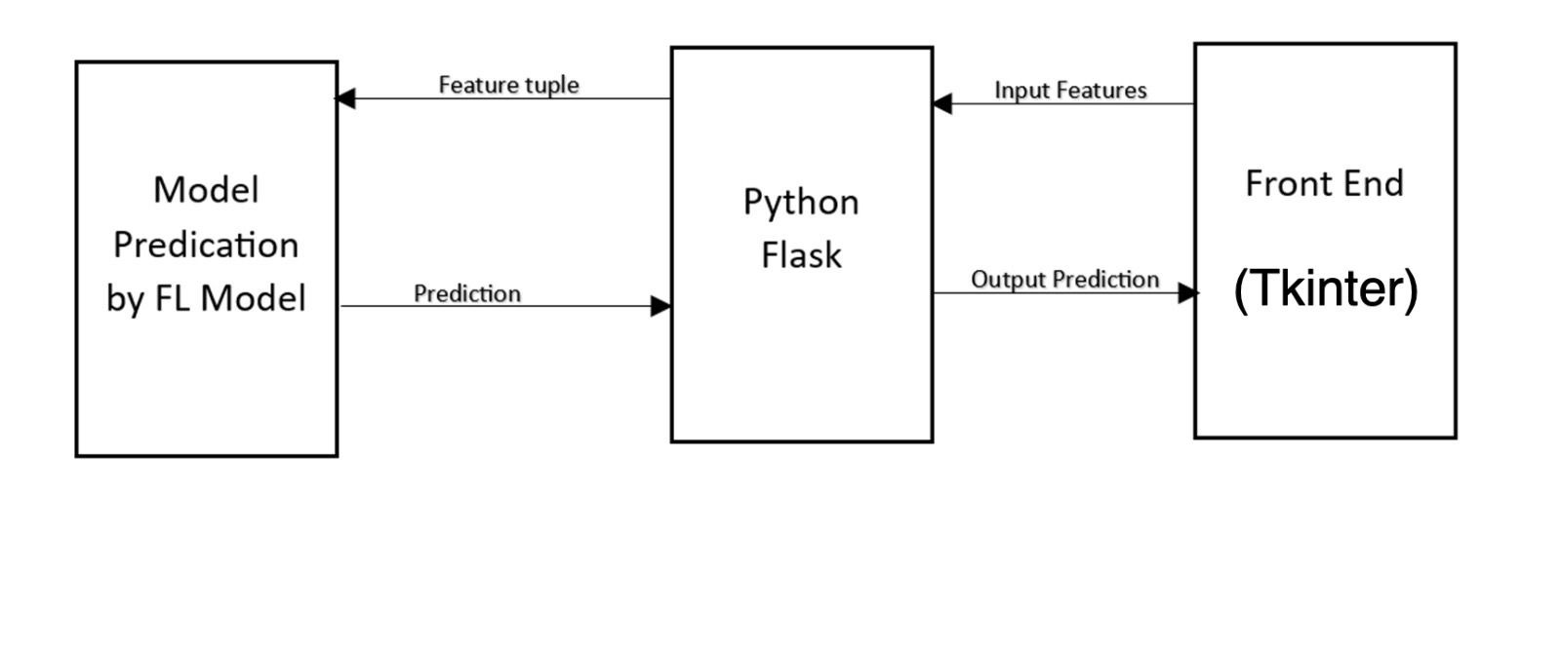
MODULE-5

Slide 32
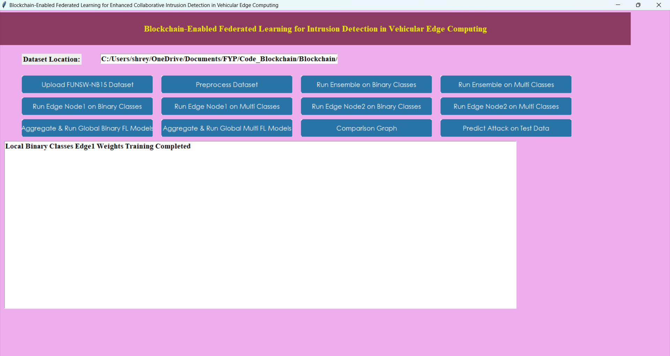
MODULE-5

Slide 33
DATASET
UNSW NB-15
Origin: Developed by the University of New South Wales and the Australian Centre for Cyber Security.
Data Generation: Simulated using the IXIA PerfectStorm tool to generate realistic network traffic, including both normal and malicious activities.
Types of Attacks: Features 9 attack categories, including:
[Denial of Service (DoS),Backdoor,Exploits,Fuzzers,Generic,Reconnaissance,Shellcode,Worms,Analysis]
Features: Consists of 49 attributes, including:
Flow features (e.g., duration, bytes, packets)
Basic features (e.g., protocol type, service, flag)
Content features (e.g., source and destination IP addresses)
Size: 2,540,044 records

Slide 34
TECHNOLOGY AND TOOLS
Federated Learning (FL)
Blockchain Technology
Python
Solidity
Truffle
Node.js
Ethereum
Ganache
Visual Studio Code

Slide 35
EVALUATION METRICS
Binary Classification Performance:The ensemble model (XGBoost, LightGBM, CatBoost) achieved 99.95% accuracy, 99.97% precision, 99.83% recall, and 99.90% F1-score, demonstrating its effectiveness in detecting attacks in binary classification with minimal errors and strong generalization.

Slide 36
EVALUATION METRICS
Multi-Class Classification Performance: The ensemble model achieved 79.93% accuracy, 73.85% precision, 70.64% recall, and 71.23% F1-score in multi-class classification, with performance challenges due to class imbalance and the complexity of distinguishing similar attack types.

Slide 37
EVALUATION METRICS
Accuracy,Precison,Recall and F1 score

Slide 38
REFERENCES
[1] M. Abdel-Basset, N. Moustafa, H. Hawash, I. Razzak, K. M. Sallam,and O. M. Elkomy, “Federated intrusion detection in blockchain-based smart transportation systems,” IEEE Trans. Intell. Transp. Syst., vol. 23, no. 3, pp. 2523–2537, Mar. 2022.
[2] Z. A. El Houda, B. Brik, and L. Khoukhi, “Ensemble learning for intrusion detection in SDN-based zero touch smart grid systems,” in Proc. IEEE 47th Conf. Local Comput. Netw. (LCN), Sep. 2022, pp. 149–156.
[3] J. Zhao, X. Chang, Y. Feng, C. H. Liu, and N. Liu, “Participant selection for federated learning with heterogeneous data in intelligent transport system,” IEEE Trans. Intell. Transp. Syst., vol. 24, no. 1, pp. 1106–1115, Jan. 2023.
[4] Z. A. E. Houda, A. Hafid, and L. Khoukhi, “Blockchain meets AMI: Towards secure advanced metering infrastructures,” in Proc. IEEE Int. Conf. Commun. (ICC), Jun. 2020, pp. 1–6.
[5] Z. A. El Houda, “Security enforcement through software defined networks (SDN),” Ph.D. dissertation, Departement d’informatique et de Recherche Operationnelle, Universite a Montreal, Montreal, QC,
Canada, 2021.

Slide 39
REFERENCES
[6] Brik, B., Z. A. El Houda, and L. Khoukhi. “Ensemble learning for intrusion detection in SDN-based zero-touch smart grid systems.” IEEE 47th Conference on Local Computer Networks (LCN), pp. 149–156, 2022.
[7] Zhou, X., Y. Liu, J. Zhang, and J. Zhao. “A differentially private federated learning model against poisoning attacks in edge computing.” IEEE Transactions on Network and Service Management, Volume 19, Issue 4, pp. 4821-4834, 2022.
[8] Feng, Y., C. H. Liu, J. Zhao, X. Chang, and N. Liu. “Participant selection for federated learning with heterogeneous data in intelligent transport system.” IEEE Transactions on Intelligent Transportation Systems, 24(1):1106–1115, Jan. 2023.
[9] Deng, X., S. Liu, J. Yu, and S. Wan. “FedCPF: An efficient communication federated learning approach for vehicular edge computing in 6G communication networks.” IEEE Transactions on Intelligent Transportation Systems, 23(2):1616–1629, Feb. 2022.
[10] Khoukhi, L., Z. A. E. Houda, A. S. Hafid, and B. Brik. “When collaborative federated learning meets blockchain to preserve privacy in healthcare.” IEEE Access, Volume 10, pages 2455–2465, Sep./Oct. 2023.

